Slide 1
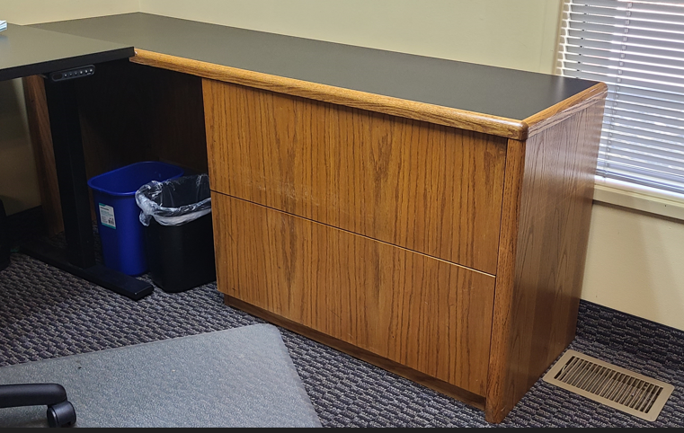
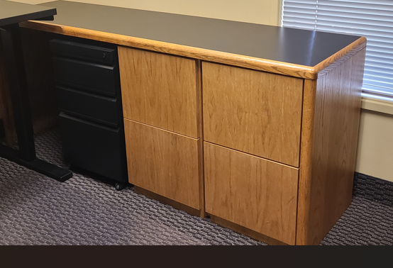
Desk Return
Measurements:
72 in long
29 in tall
20 in deep
2 long file drawers
Qty: 4
A
B
Desk Return
Measurements:
72 in long
29 in tall
20 in deep
4 regular file drawers
Qty: 12
-1-

Slide 2
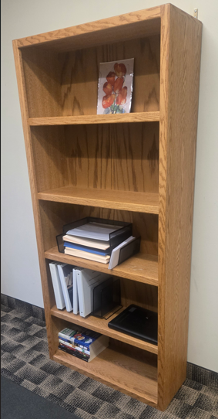
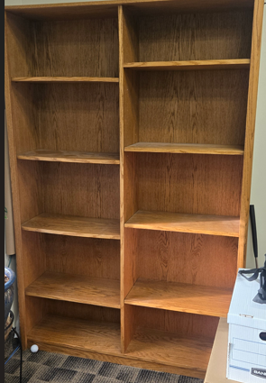
Dual Bookshelf
Measurements:
76 in tall
48 in wide
12 in deep
Qty 1
Bookshelf
Measurements:
72 in tall
33 in wide
12 in deep
Qty: 3
B
A
-2-

